Slide 1
PROBABILITY & STATISTICS
Chapter 4: Continuous Random Variables and Probability Distributions
LEARNING OBJECTIVES
1. Continuous random variable:
(a) Probability density function
(b) Cumulative distribution function
(c) Mean and Variance
2. Common distribution: uniform and normal
3. Normal approximation to the Binomial and Poisson.

Slide 2
CONTINUOUS RANDOM VARIABLE
Continuous R.V
Definition
A continuous random variable is a random variable whose possible values includes in an interval of real numbers.
Hours spent studying in a day
0
3
6
9
12
15
18
21
24
The time spent studying can be any number between 0 and 24.

Slide 3

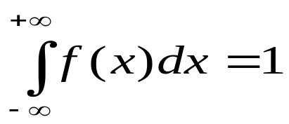
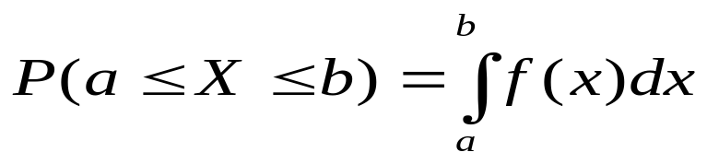
PROBABILITY DENSITY FUNCTION
Definition
Pdf
The probability density function (pdf) of a continuous random variable X is a function such that
(1)
(2)
(3)
for any a and b.

Slide 4
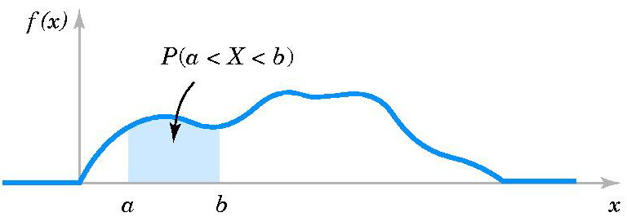
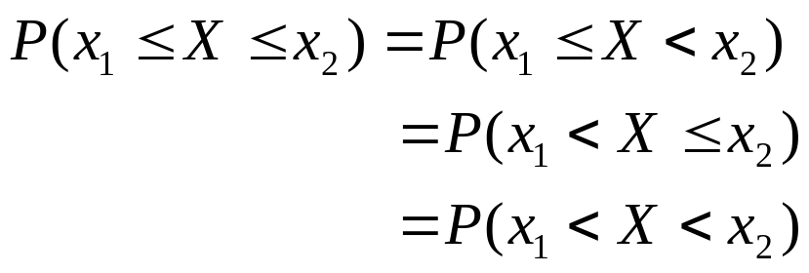
PROBABILITY DENSITY FUNCTION
Pdf
Figure 4-2 Probability determined from the area under f(x).
Property
If X is a continuous random variable then for any x₁ and x₂ we have

Slide 5

PROBABILITY DENSITY FUNCTION
Example
Pdf
Let the continuous random variable X denote the diameter of a hole drilled in a sheet metal component. The target diameter is 12.5 millimeters. Most random disturbances to the process result in larger diameters. Historical data show that the distribution of X can be modeled by a probability density function
(a) If a part with a diameter larger than 12.60 millimeters is scrapped, what proportion of parts is scrapped?
(b) What proportion of parts is between 12.5 and 12.6 millimeters?

Slide 6
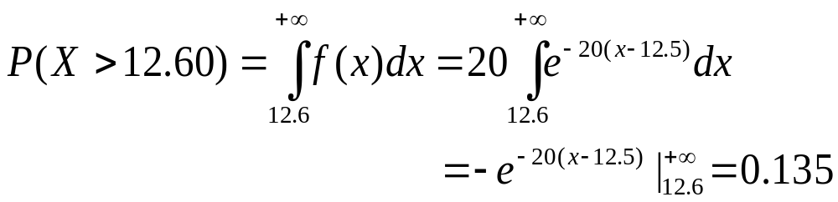
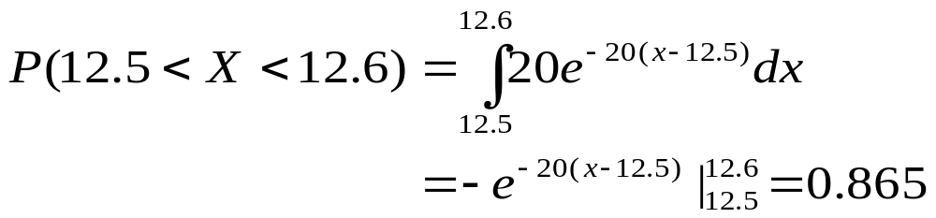
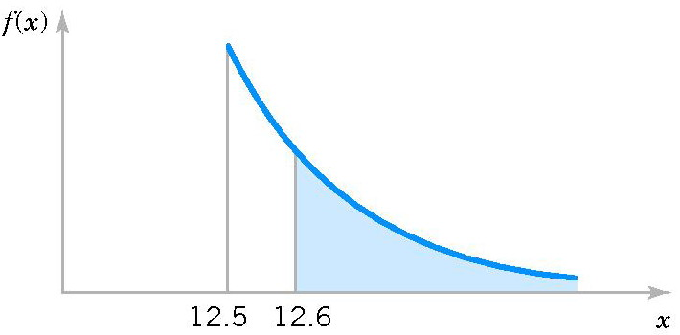
PROBABILITY DENSITY FUNCTION
Solution
Pdf
(a)
(b)
P(X > 12.60)

Slide 7
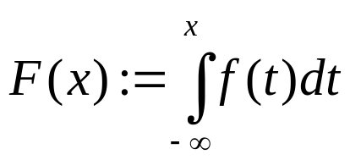
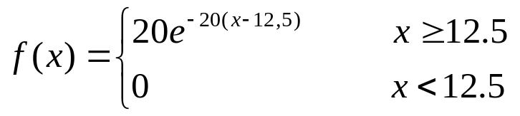
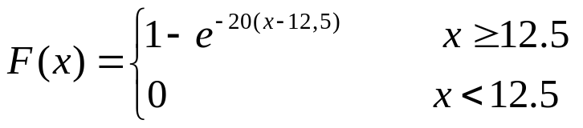
CUMULATIVE DISTRIBUTION FUNCTION
Definition
The cumulative distribution function (cdf ) of a continuous random variable X is
for -∞ < x < +∞.
Cdf
Let us return to the above example

Slide 8
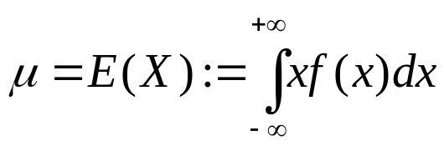
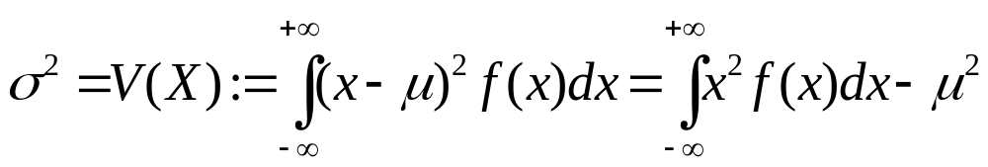
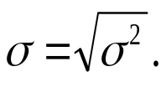
MEAN AND VARIANCE
Definition
Suppose X is a continuous random variable with probability density function f(x).
The mean or expected value of X is defined by
The variance of X is defined by
The standard deviation of X is
Mean & Variance

Slide 9
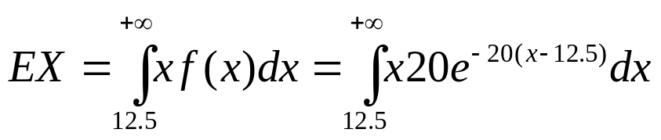
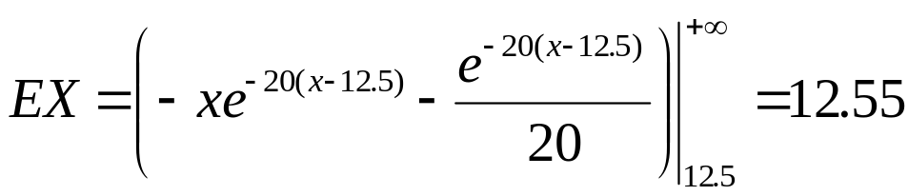
MEAN AND VARIANCE
Example
Assume that X is a continuous random variable with the following probability density function
Mean & Variance
Mean:
Integration by parts can be used to show that

Slide 10
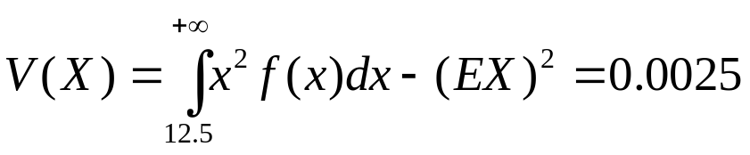
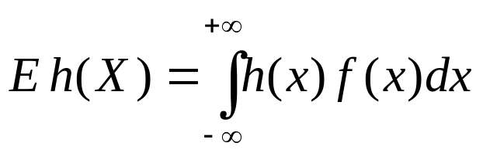
MEAN AND VARIANCE
Variance:
Mean & Variance
Expected Value of a Function of a Continuous Random Variable

Slide 11
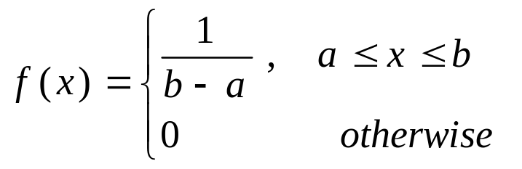
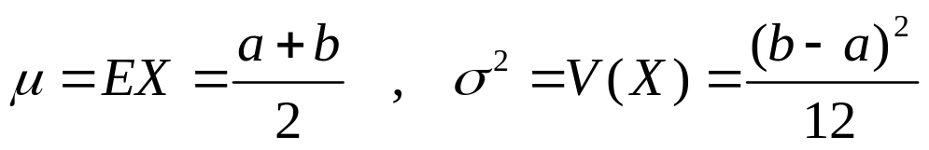
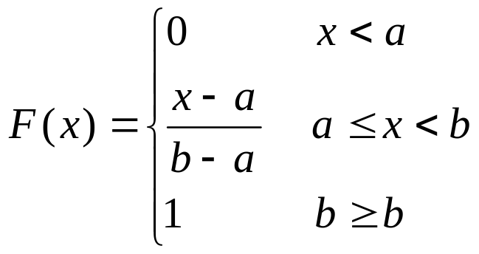
CONTINUOUS UNIFORM RANDOM VARIABLE
Continuous uniform random variable over interval [a, b]
pdf:
Uniform
Mean and Variance:
cdf:

Slide 12
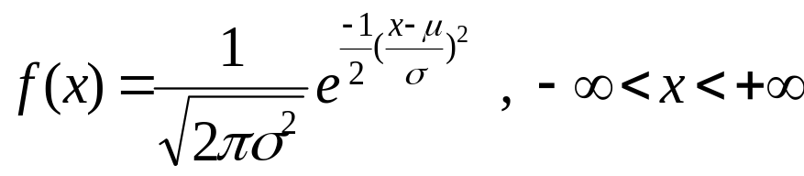
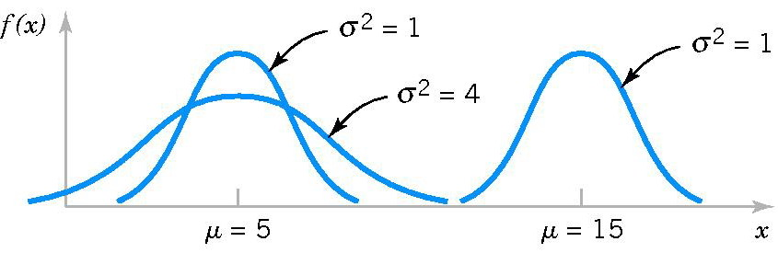
NORMAL DISTRIBUTION
Normal random variable X ~ N(µ, σ²)
pdf:
Mean and Variance:
E(X) = µ V(X) = σ²
Normal

Slide 13
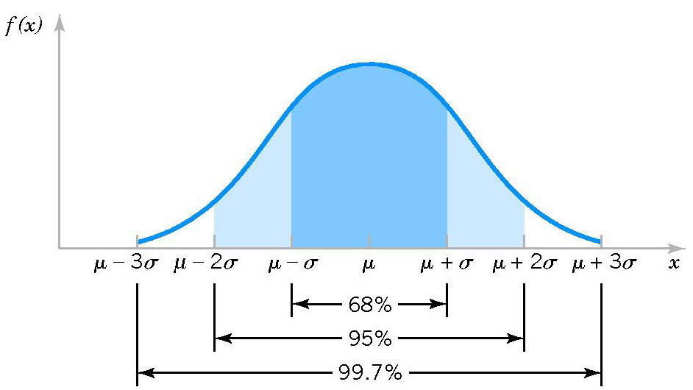
NORMAL DISTRIBUTION
3σ-rule
Normal

Slide 14
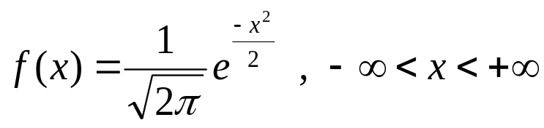
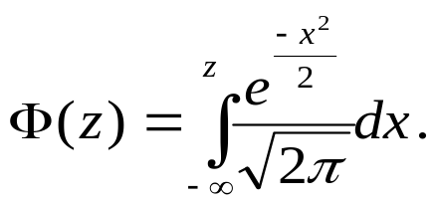
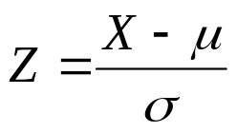
NORMAL DISTRIBUTION
Standard Normal Random Variable Z ~ N(0,1)
pdf:
cdf:
Normal
Standardizing
If X is a normal random variable X ~ N(µ, σ²) then
is a standard normal random variable N(0, 1).

Slide 15
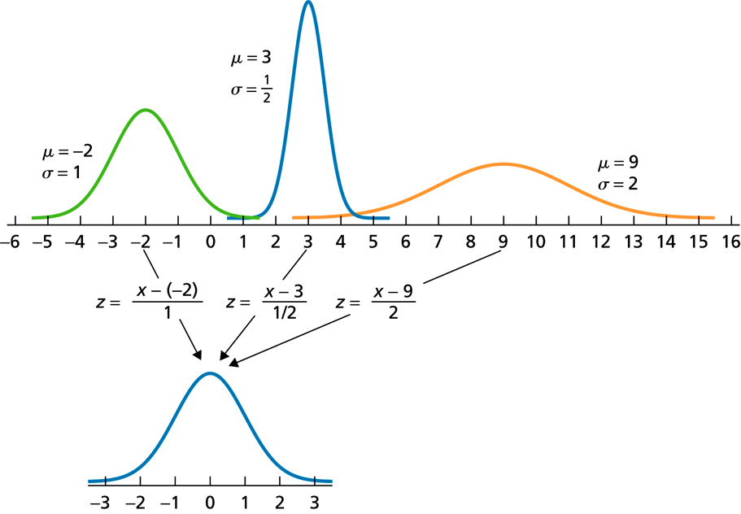
NORMAL DISTRIBUTION
Standardizing
Normal

Slide 16
NORMAL DISTRIBUTION
Finding Probabilities
Problem 1: x is given known, find P(X < x).
Problem 2: P(X < x) = p is given known, find x.
Using Excel
Z ~ N(0,1)
To find P(Z < z) when given z: =NORMSDIST(z)
To find z when P(Z < z) = p: =NORMSINV(p)
Normal
2. X ~ N(μ, σ²)
To find P(X < x) when given x: =NORMDIST(x, μ, σ,1)
To find x when P(X < x) = p: =NORMINV(p, μ, σ).

Slide 17
NORMAL DISTRIBUTION
Example
(a) Let X ~ N(34, 144). Find P(X < 43) and P(24 < X < 37).
(b) Let Z ~ N(0,1). Find the value of z to P(Z > z) = 0.95
(a) P(X < 43) = NORMDIST(43, 34, 12,1) = 0.7734
P(24 < X < 37) = P(X < 37) – P(X < 24)
= 0.5987 – 0.2023 =0.3964
(b) P(Z < z) = 1 – P(Z > z) = 1 – 0.95 = 0.05
z =NORMSINV(0.05) = -1.65
Normal

Slide 18
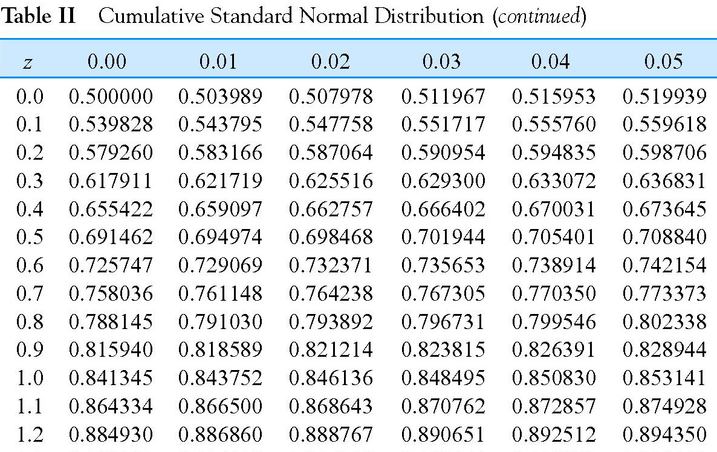
NORMAL DISTRIBUTION
Finding Probabilities: Using Table II
Normal

Slide 19
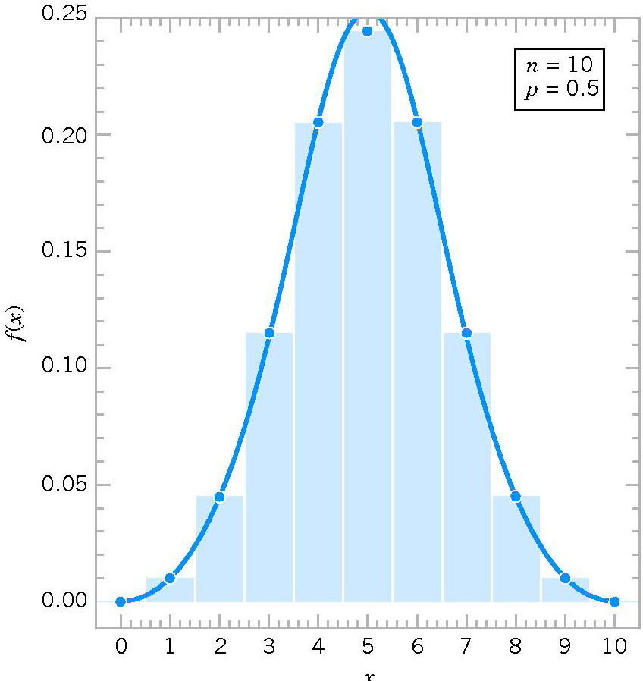
NORMAL APPROXIMATION
Under certain conditions, the normal distribution can be used to approximate the binomial distribution and the Poisson distribution.
Normal approxi.

Slide 20
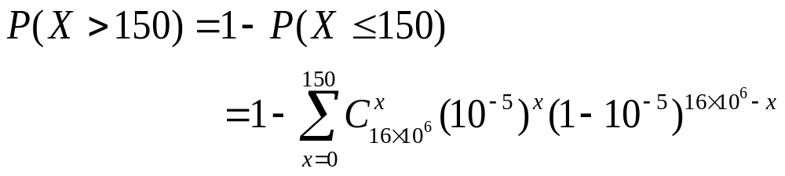
NORMAL APPROXIMATION
Example
Let X ~ B(16×10⁶, 10⁻⁵). Find the probability P(X >150).
Solution
Normal approxi.
Clearly, this probability is difficult to compute.

Slide 21
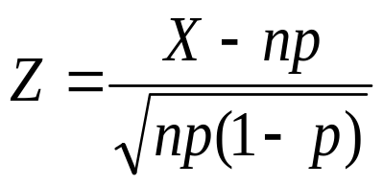
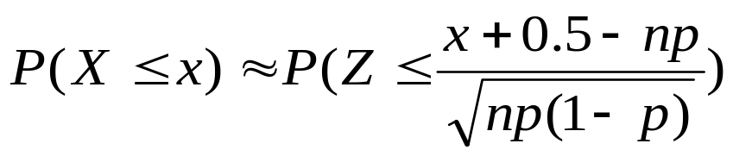
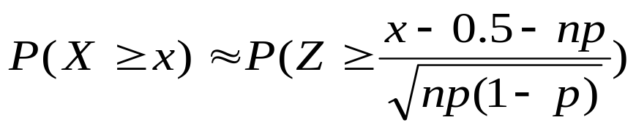
NORMAL APPROXIMATION
Normal Approximation to the Binomial Distribution
If X ~ B(n, p) then random variable
is approximately a standard random variable N(0,1).
Normal approxi.
Remark: The approximation is good for np > 5 and n(1-p) > 5.

Slide 22
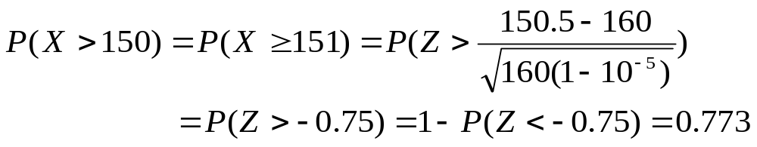
NORMAL APPROXIMATION
Let us return to the above example
Here, we use the result np = 16×10⁶×10⁻⁵ = 160.
Normal approxi.

Slide 23
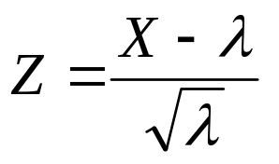
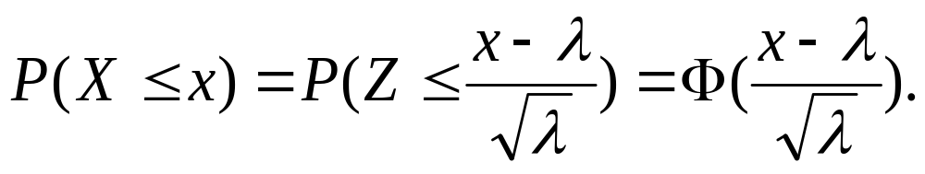
NORMAL APPROXIMATION
Normal Approximation to the Poisson Distribution
If X is a Poisson random variable P(λ) then
is approximately a standard random variable N(0,1).
The approximation is good for λ > 5.
Normal approxi.

Slide 24
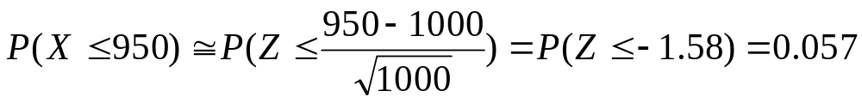
NORMAL APPROXIMATION
Example
Assume that the number of asbestos particles in a squared meter of dust on a surface follows a Poisson distribution with a mean of 1000. If a squared meter of dust is analyzed, what is the probability that less than 950 particles are found?
Let X = the number of asbestos particles in a squared meter of dust on a surface, then X ~ P(1000)
Normal approxi.

Slide 25
SUMMARY
We have studied:
1. Continuous random variable:
(a) Probability density function
(b) Cumulative distribution function
(c) Mean and Variance
2. Common distribution: uniform and normal
3. Normal approximation to the Binomial and Poisson.
Summary
Homework: Read slides of the next lecture.

